Slide 1




title to come!
Leo Portes^{1,2}, Mark Jessell^{1,2,3}, Mark Lindsay^{2,4}, Guillaume Pirot^{1,2,3}, Michel Nzikou^{1,3}, Ed Cripps^{1,2}
¹UWA, ²ITTC DARE, ³MinEx CRC, ⁴CSIRO

Slide 2
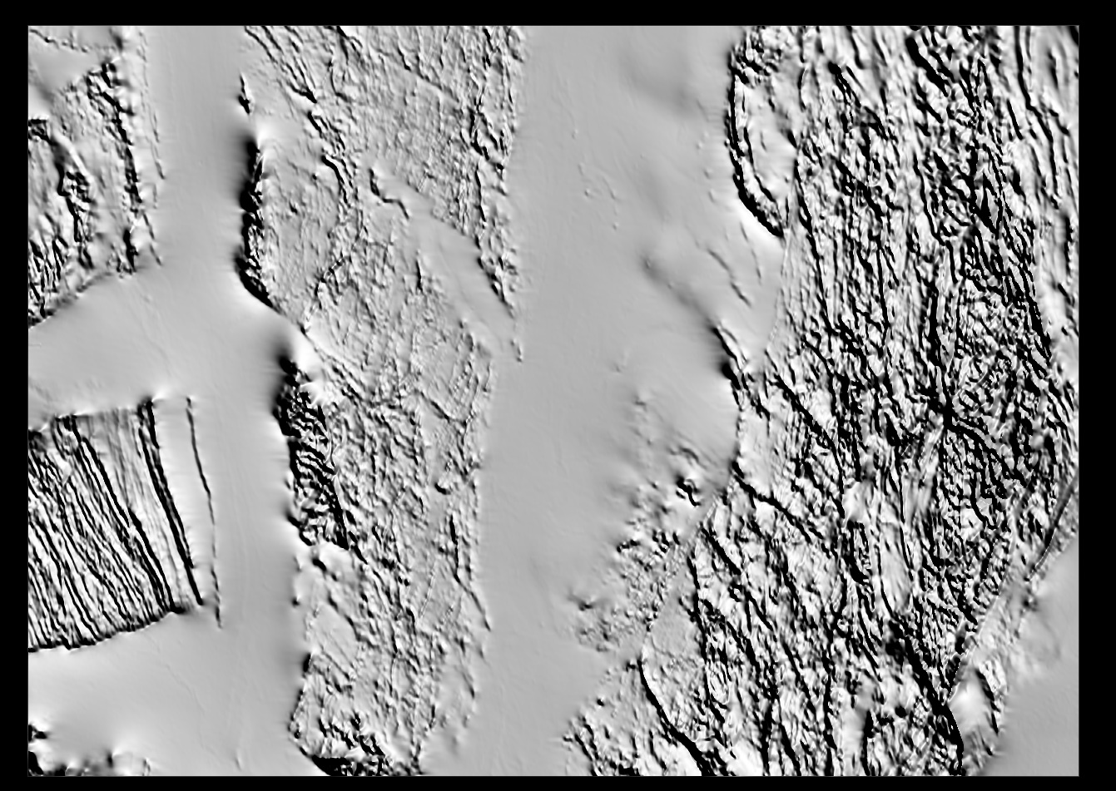
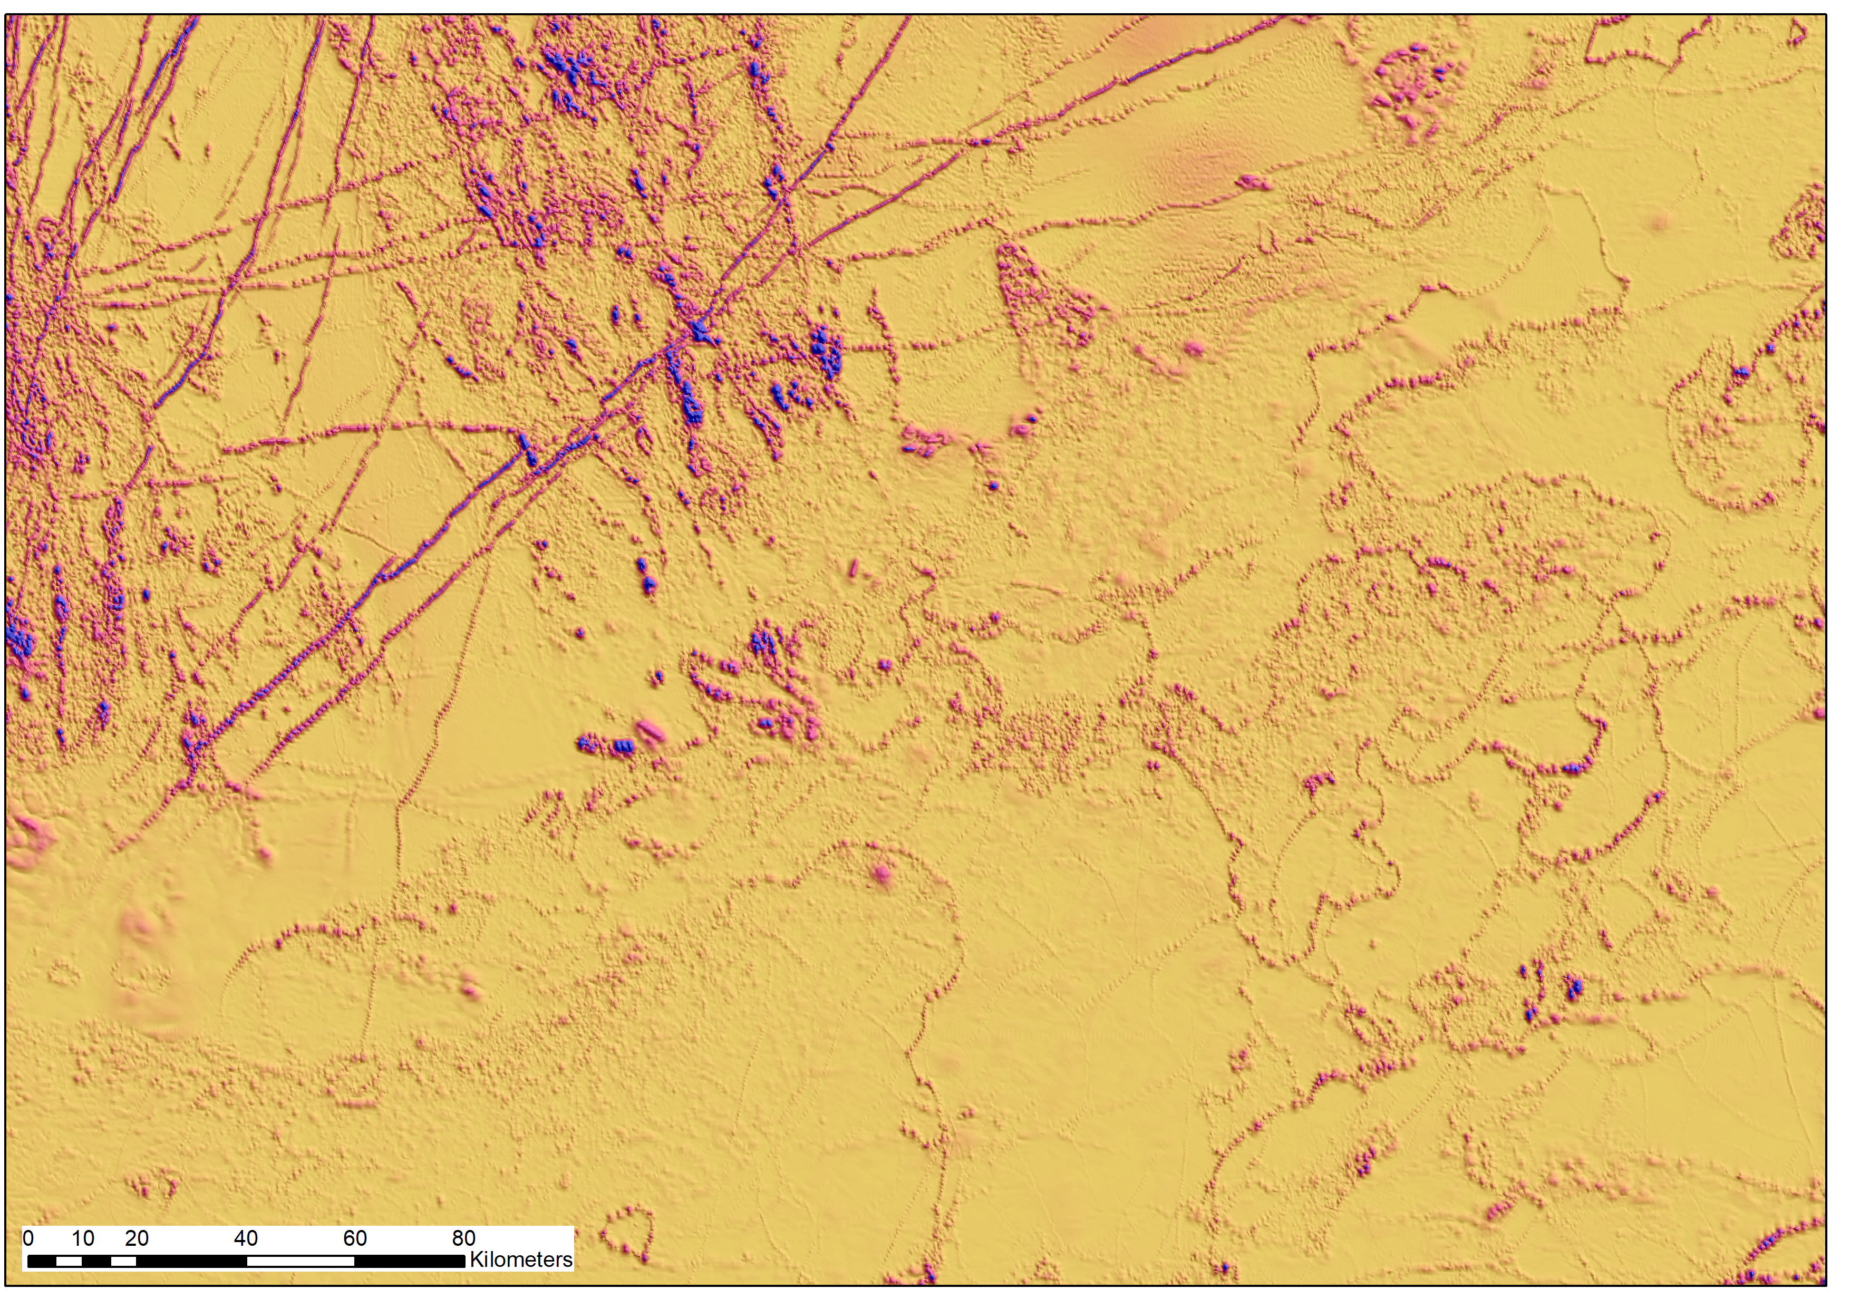
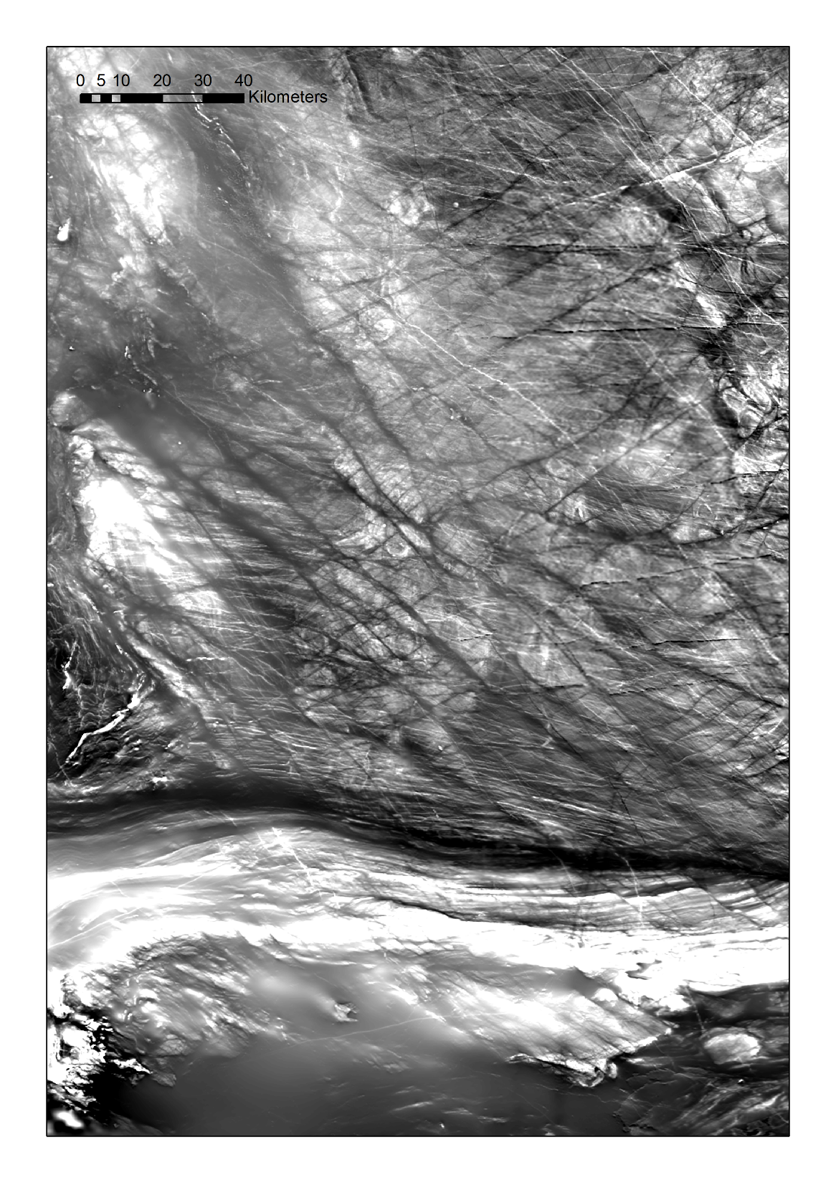
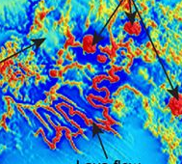
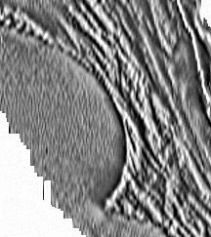
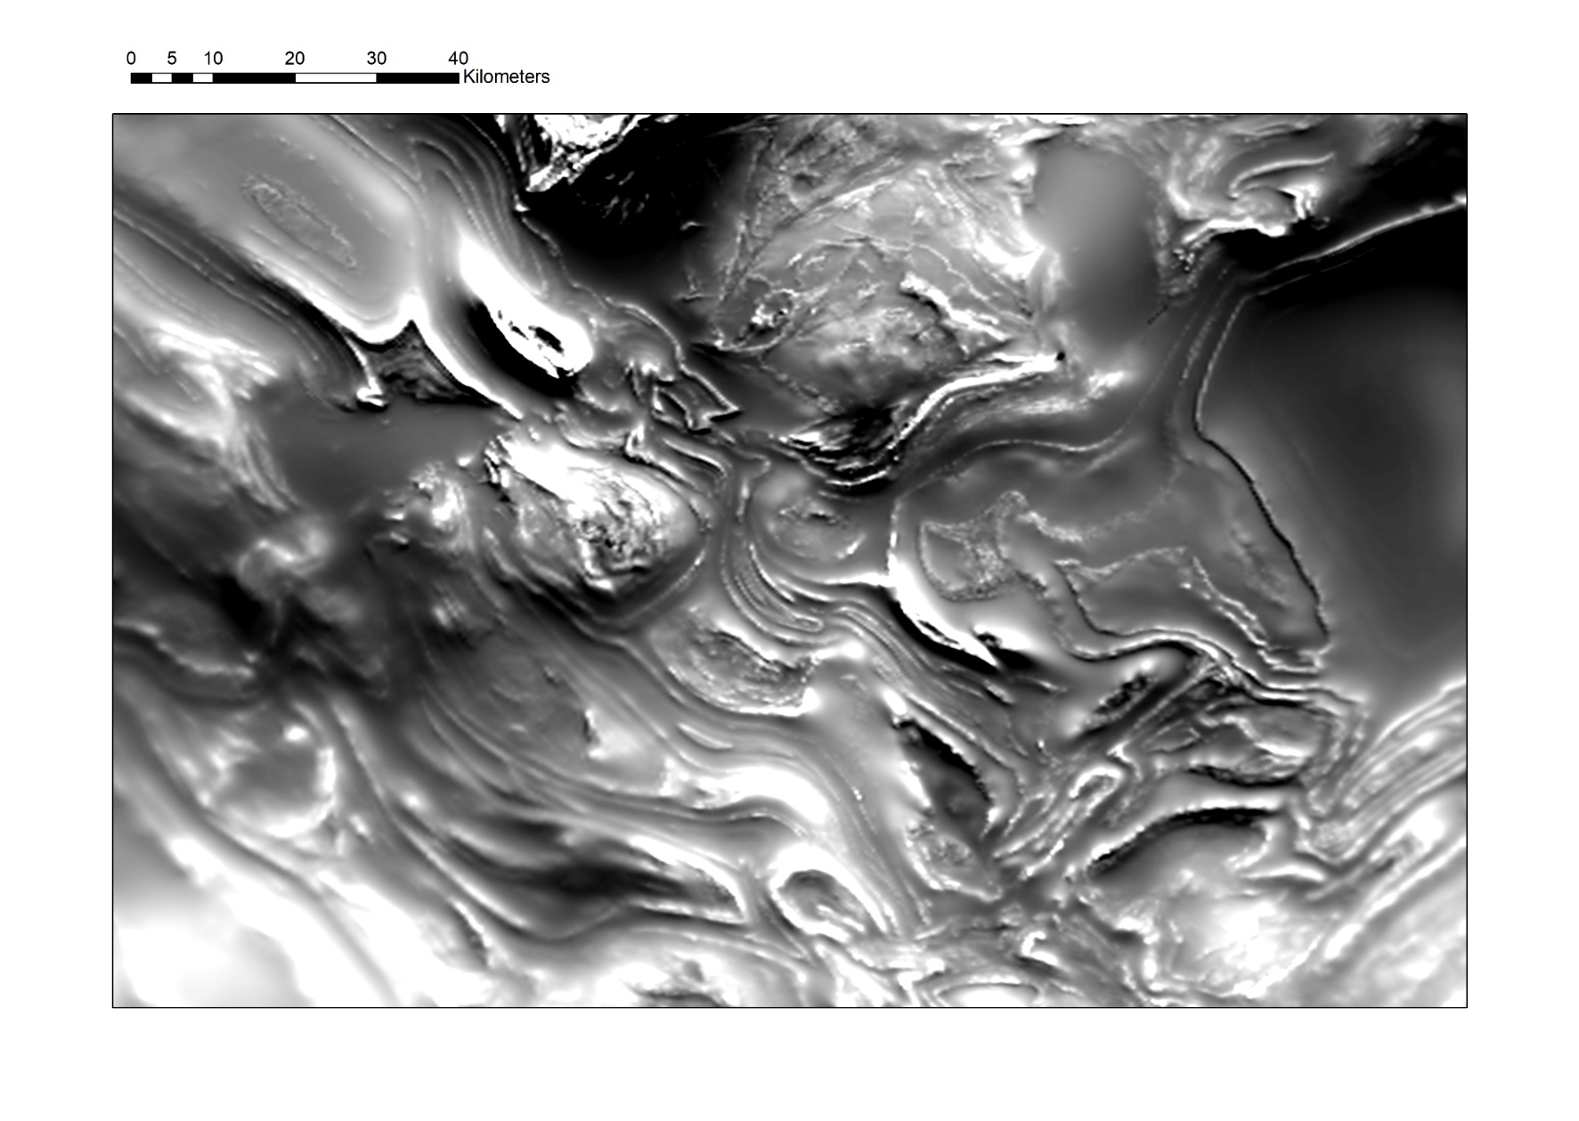
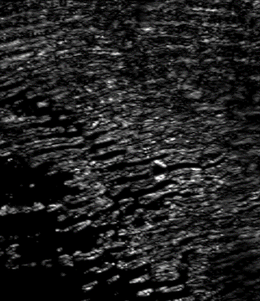
The challenge: Extracting geological meaning from geophysical data, e.g. Single or multiple linear features
Stratigraphy
Sills
Dykes
Faults
Lava Flows
Pluton margins
Folds
Paleochannels
Sand Dunes

Slide 3

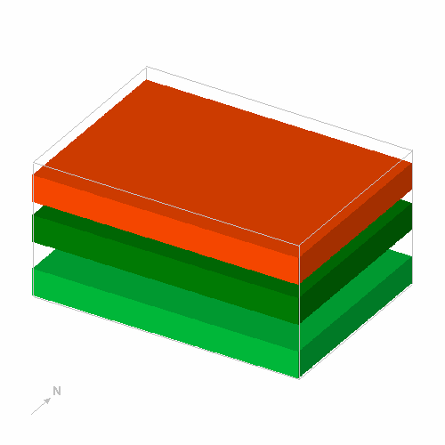
Noddy
Semantic/kinematic/implicit modelling engine
Calculates 3D models based on an idealised description of the kinematics of a sequence of geological events
Density, magnetic susceptibility ( K_{ij} ) and remanence properties assigned to each unit so we can calculate gravity and magnetic responses
Jessell, 1981

Slide 4
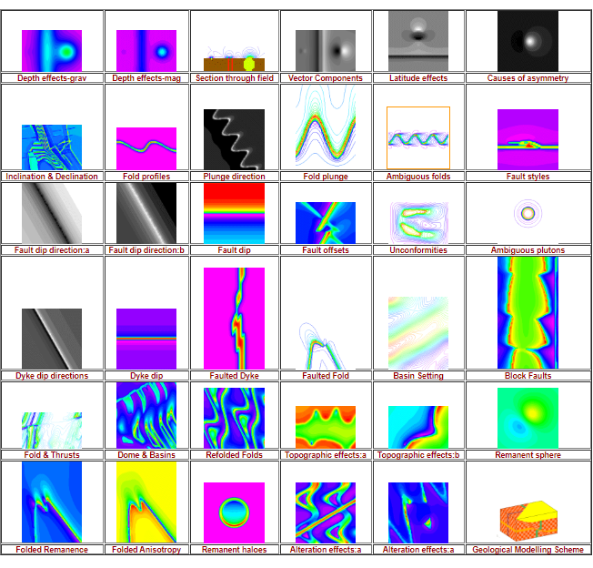
Atlas of Structural Geophysics
http://tectonique.net/asg
Human learning dataset

Slide 5
Farrell et al., 1996
Genetic Algorithm sampling of Noddy model space for geophysical inversion
Generate 10 random Models
Check against Real Data
Best model
“Best” solution not found
Return best model
Create new generation of models
Breed new models
Generate new random models
Discard worst models

Slide 6
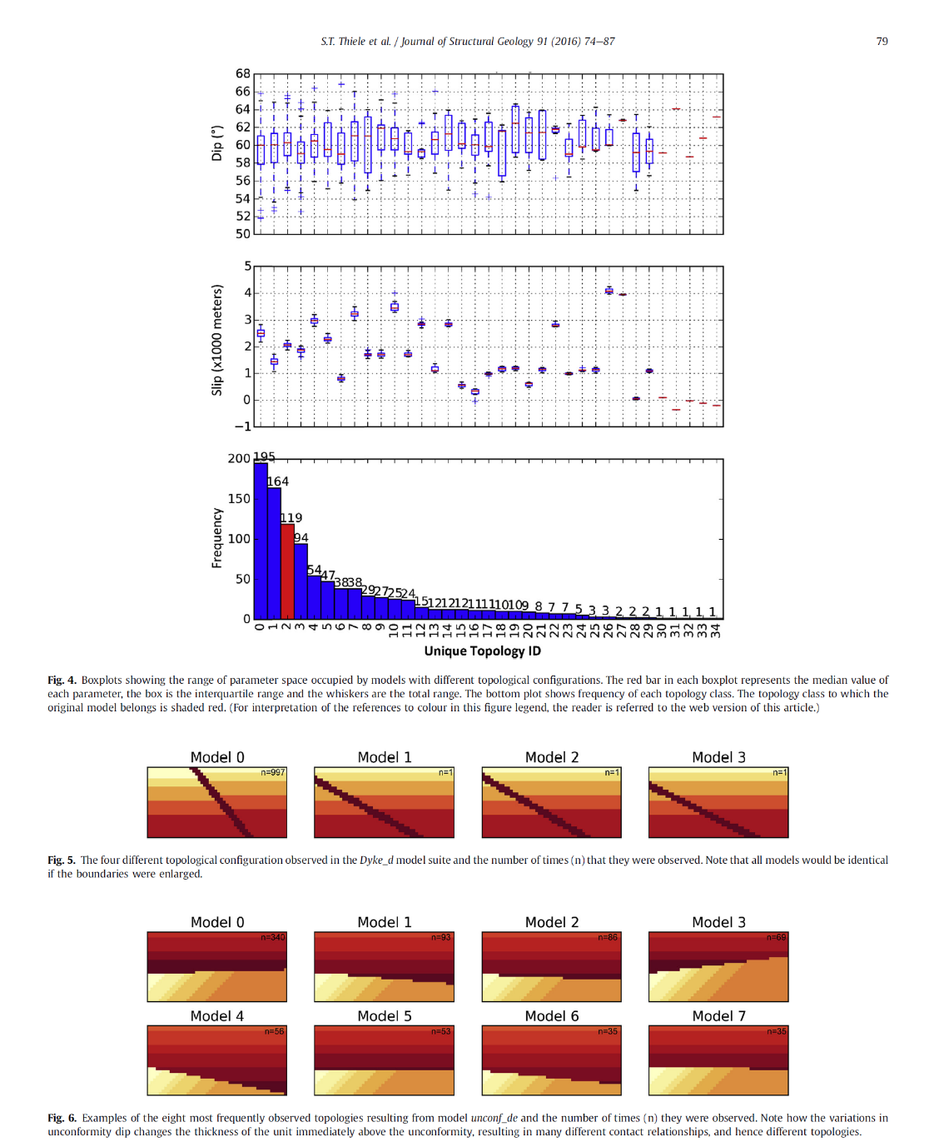
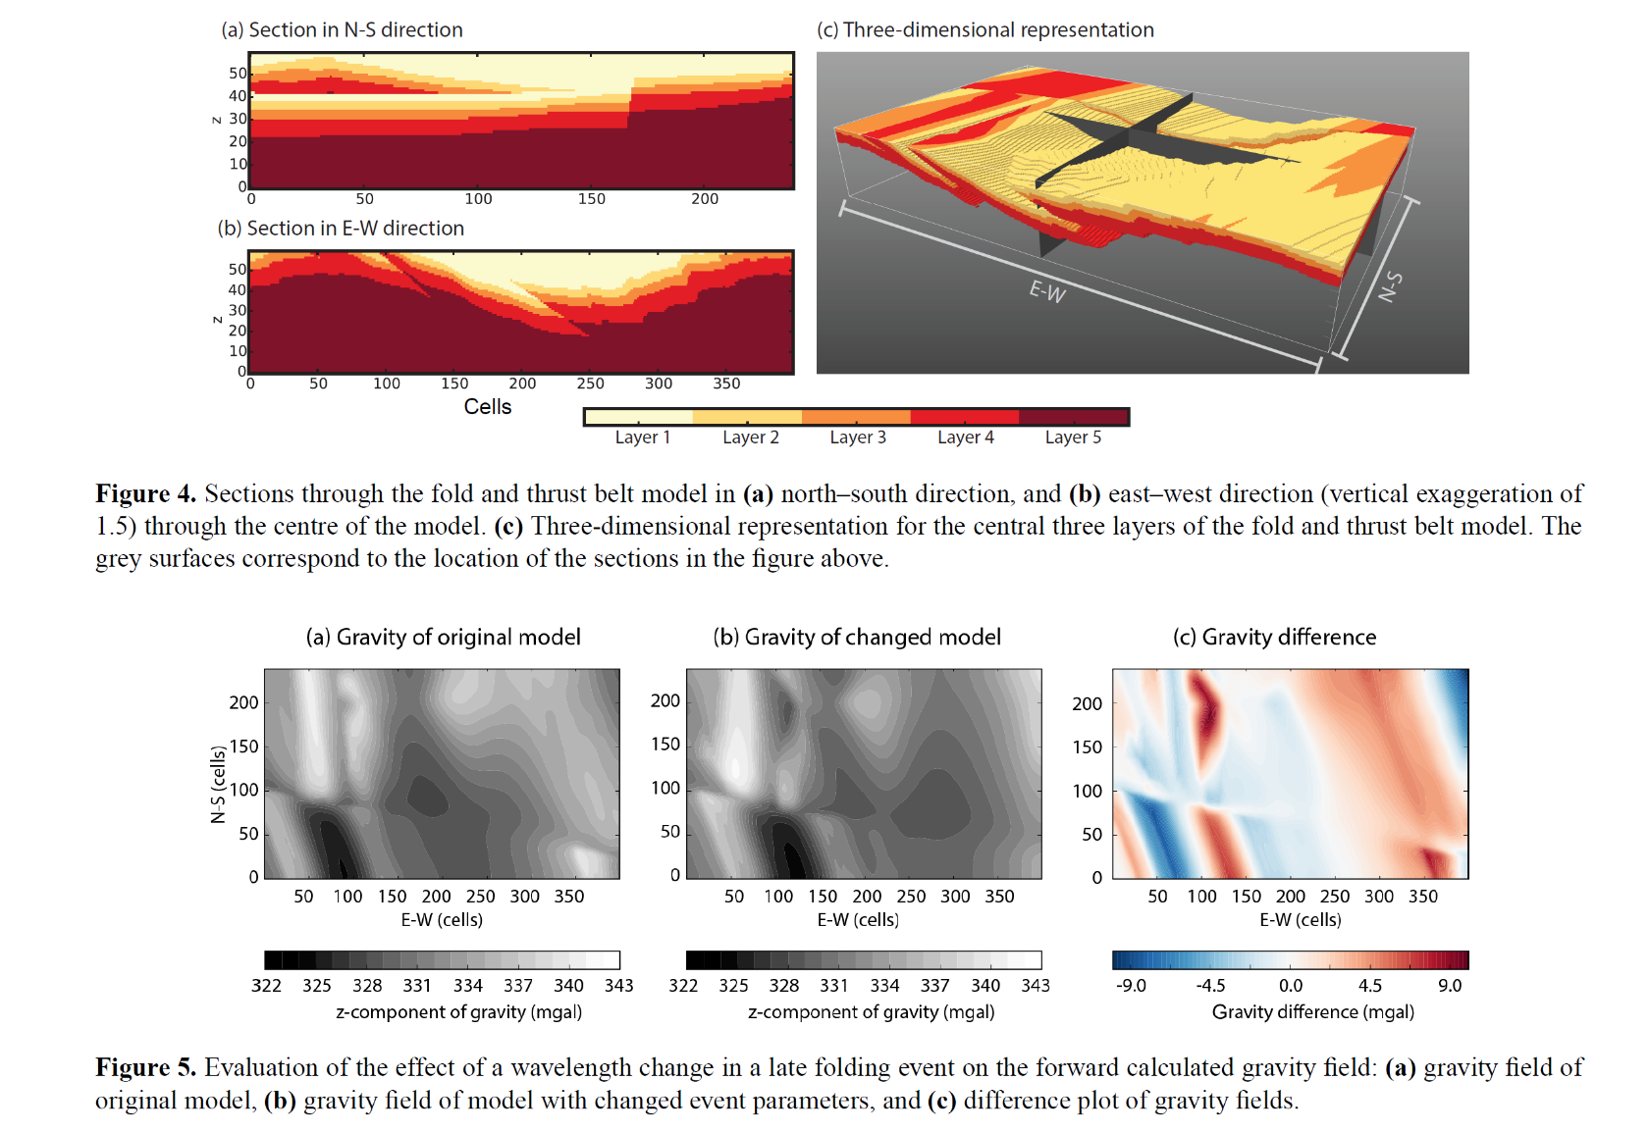
Wellmann et al. 2016 pynoddy
Thiele et al 2016. topological uncertainty

Slide 7
How to make a random model…
Base Stratigraphy + Tilt + 3 random events with random spatial & orientation parameters
= 343 event orders (e.g. STRAT-TILT-FOLD-DYKE-SHEA)
~ 60-70 independent variables per history
Lots of arbitrary decisions:
Size of model (4k x 4k x 4k)
Size of voxels (20m x 20m x 20m)
Number of random events (3)
Start with Strat & Tilt event
Range and Probability Density Function of parameters for each event
What range of wavelengths do folds form in nature?
How wide are mafic dykes usually, Felsic dykes? Petrophysically coherent stratigraphic units?
Allowable events:
Fold
Fault
Unconformity
Shear Zone
Dyke
Plug
Tilt
Each model and associated geophysics takes ~5-10 seconds to run on a multi-core laptop
200,000 cpu hours would allows us to make 72M models

Slide 8
Karpatne et al. (2017) summarise the principal challenges to applying Machine Learning to the geosciences:
Spatio-temporal structure
High dimensionality
Paucity of ground truth
Objects with amorphous boundaries
Heterogeneity in space and time
Interest in rare phenomena
Multi-resolution data
Noise, incompleteness and uncertainty in data
Karpatne et al. (2017) Machine Learning for the Geosciences: Challenges and Opportunities. IEEE Transactions on Knowledge and Data Engineering 10.1109/TKDE.2018.2861006

Slide 9
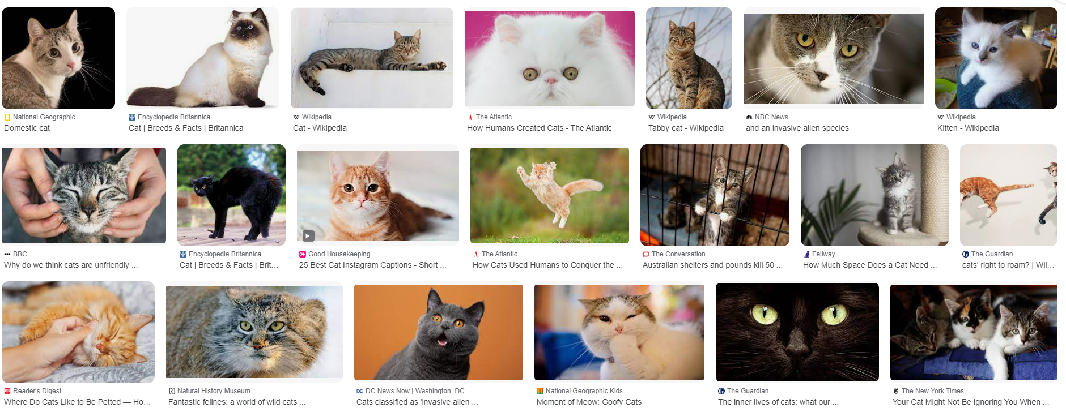

As reported by CNN*, there are estimated to be 6 Billion images of cats indexed by Google
*reliable source

Slide 10
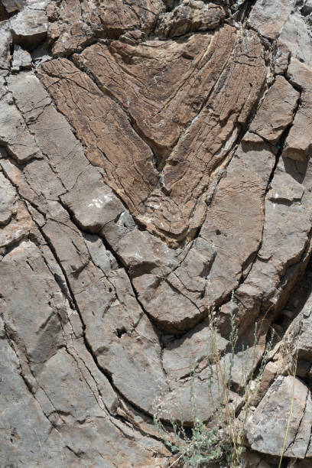
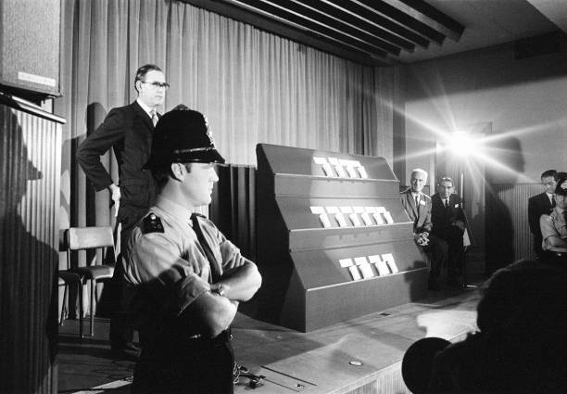

Google Image search has ~700 images of “geological folds”

Slide 11
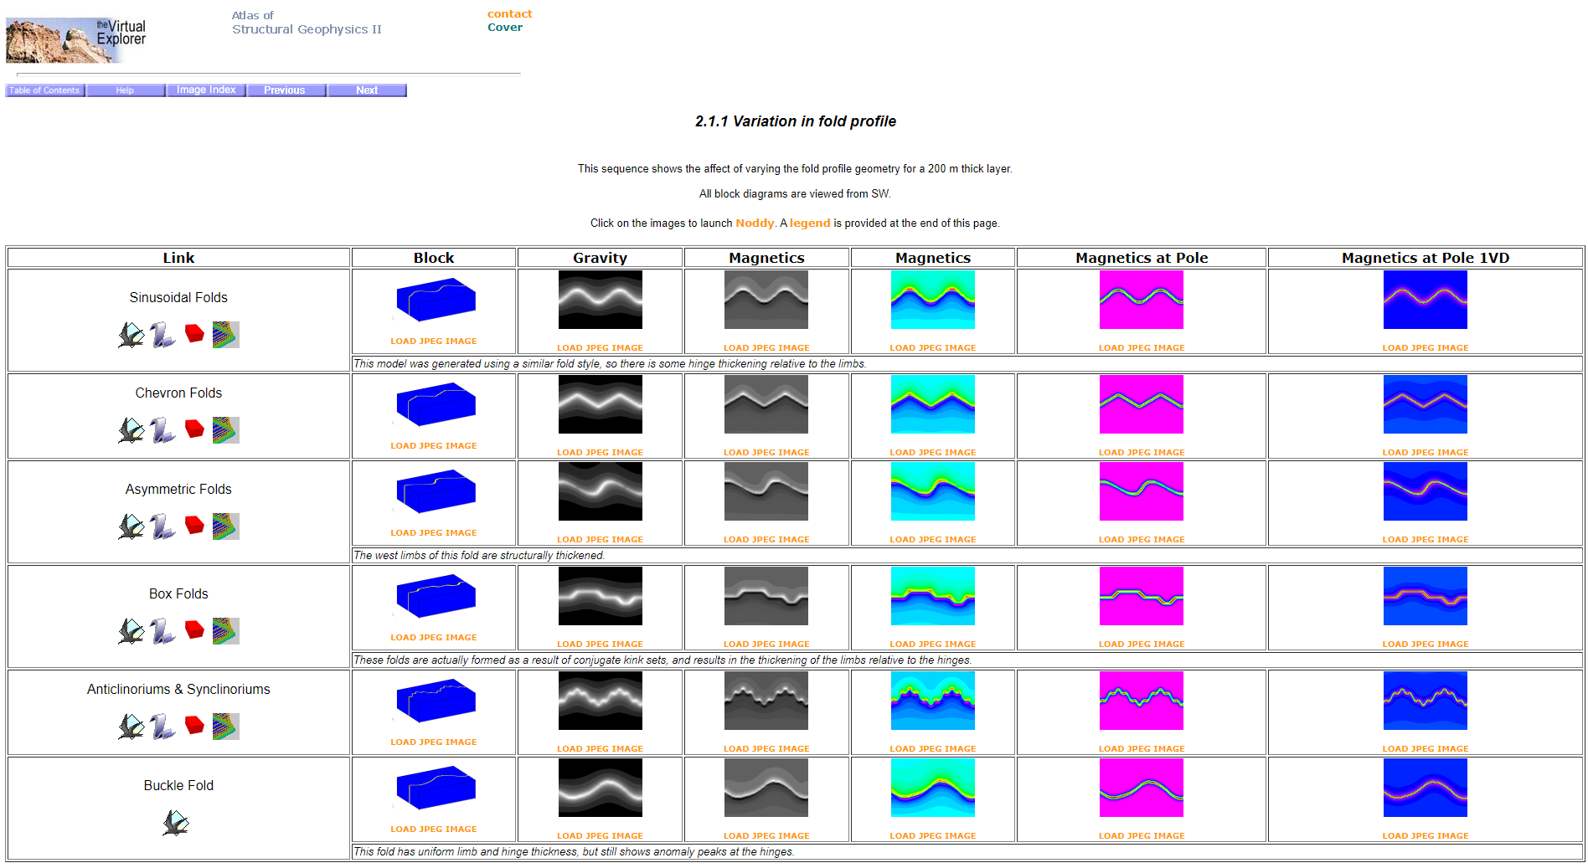
Google has 0 images of “geological folds in magnetic data”
tectonique.net/asg

Slide 12
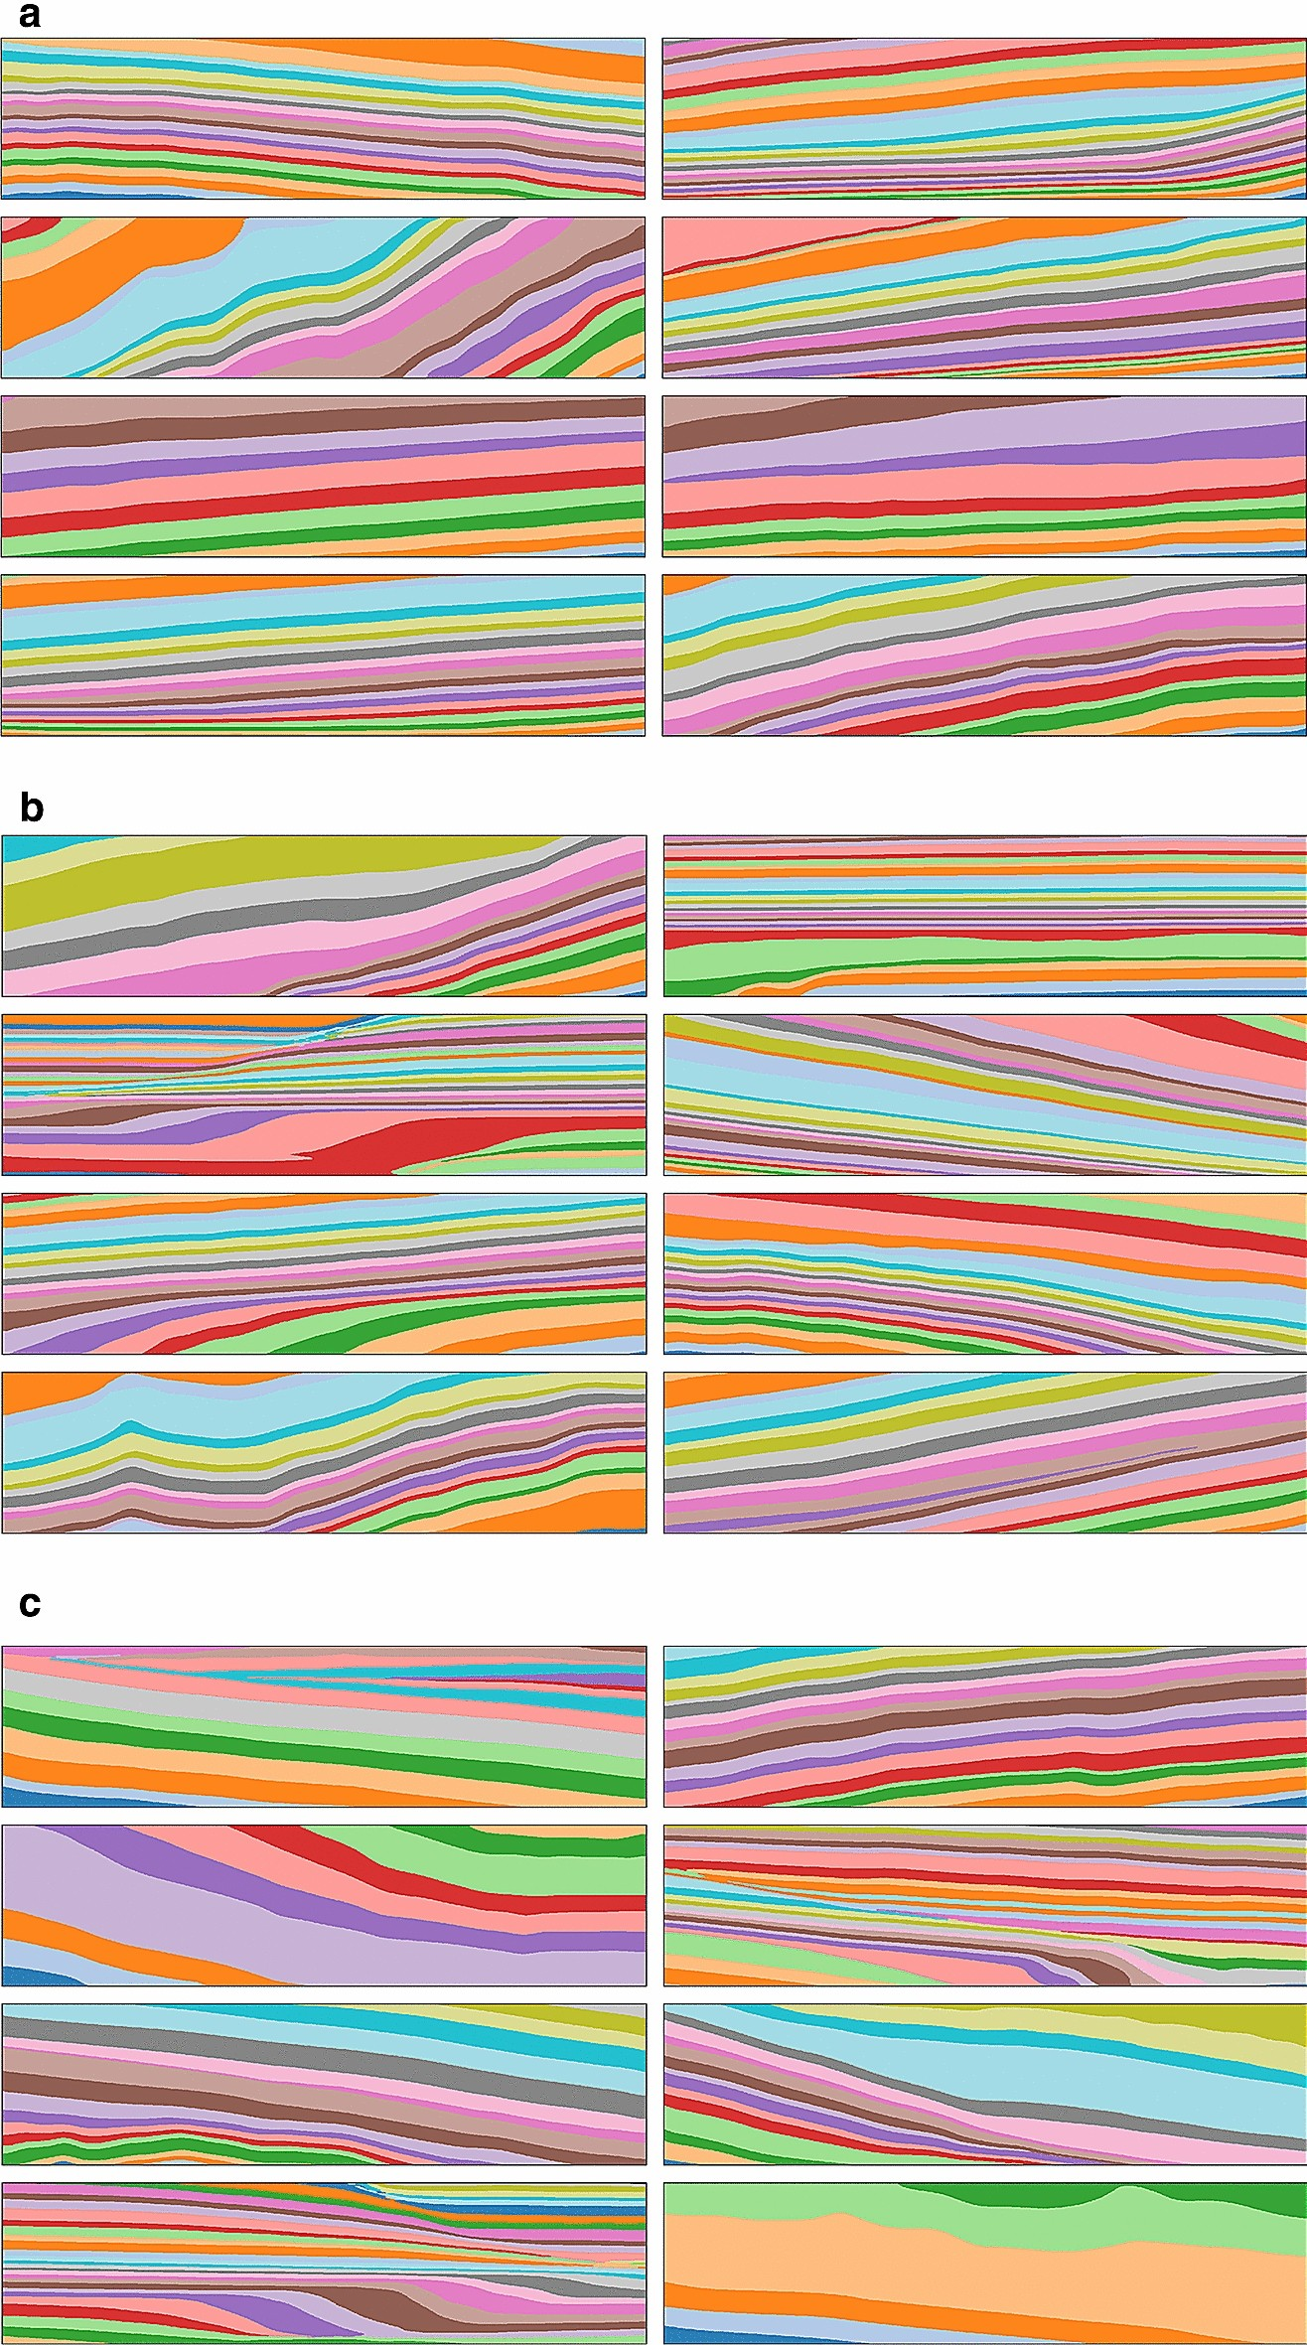
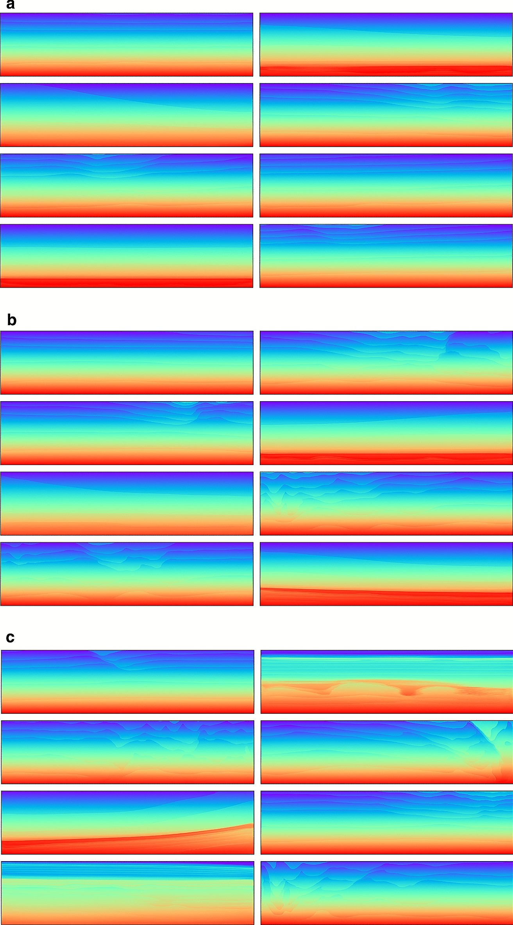
ClinoformNet-1.0: stratigraphic forward modeling and deep learning for seismic clinoform delineation
Hui Gao et al., Geoscientific Model Development, 2022-245
Geophysical model generation with generative adversarial networks
Puzyrev et al., Geoscience Letters 32 2022

Slide 13

Another Solution for more complex 3D geology?
We are using Noddy to generate very large training sets for 3D geology and resulting gravity and magnetic datasets as inputs to ML systems and as tests of geophysical inversion schemes
Spatio-temporal structure
High dimensionality
Paucity of ground truth

Slide 14
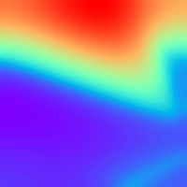

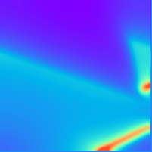
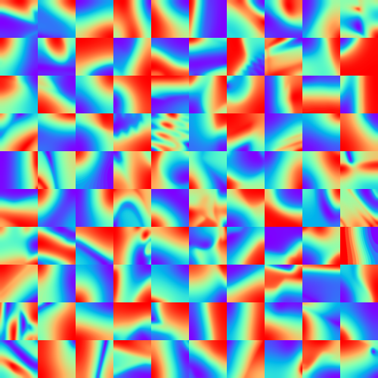
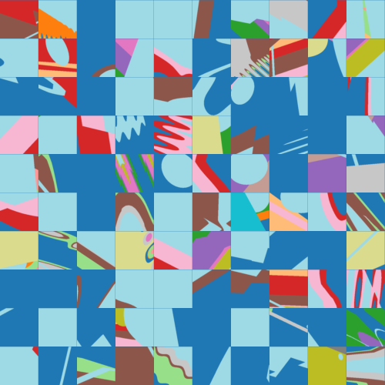
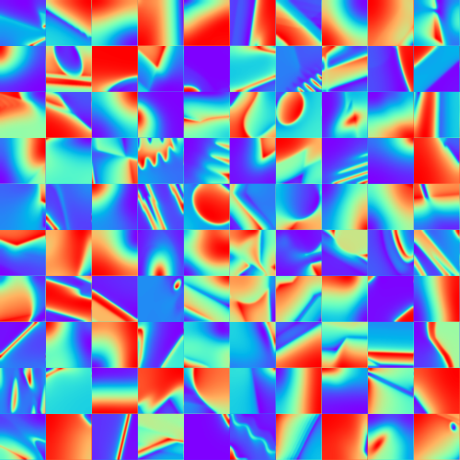
Example models
100 randomly generated models randomly selected from database
4kx4kx4k
20m voxels
grav
Top surface of model
mag

Slide 15
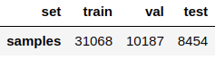
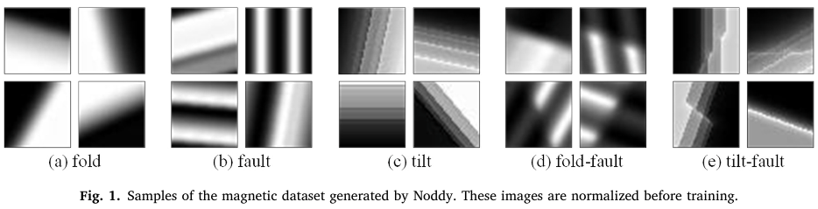
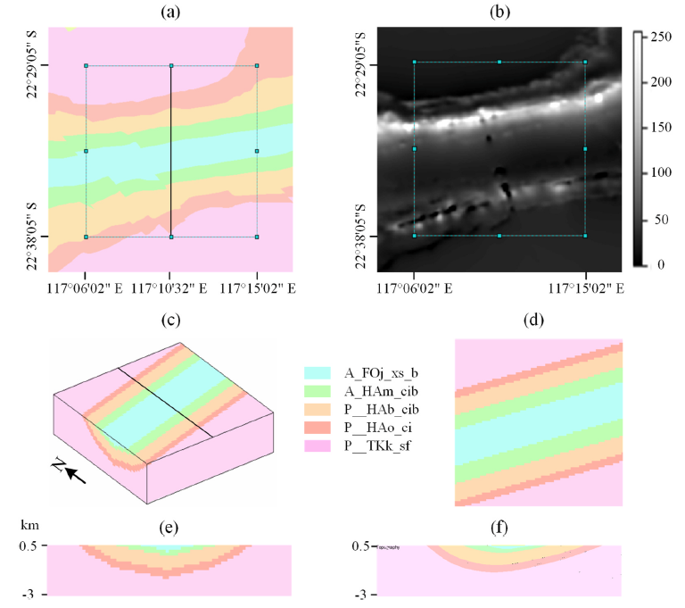
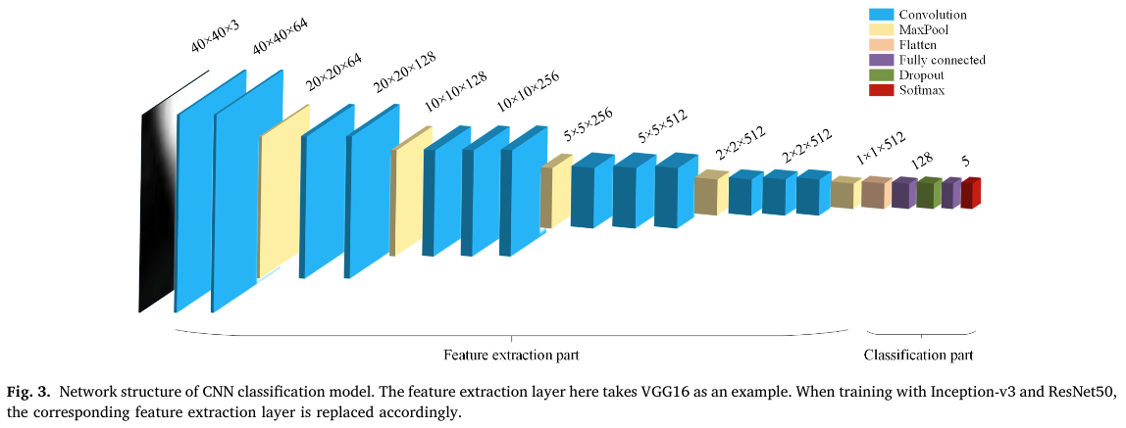
Goal: predict the parameters of the geological structure (eg, dip direction and the dip angle of the fold axial surface)
Magnetic field 2D images
Noddy dataset, ~50k samples
Classifier
Inception-v3
(very deep) CNN
~1 day training
3D geological structure inversion from Noddy-generated magnetic data using deep learning methods, Guo et al., Computers & Geosciences 2021, 104701

Slide 16
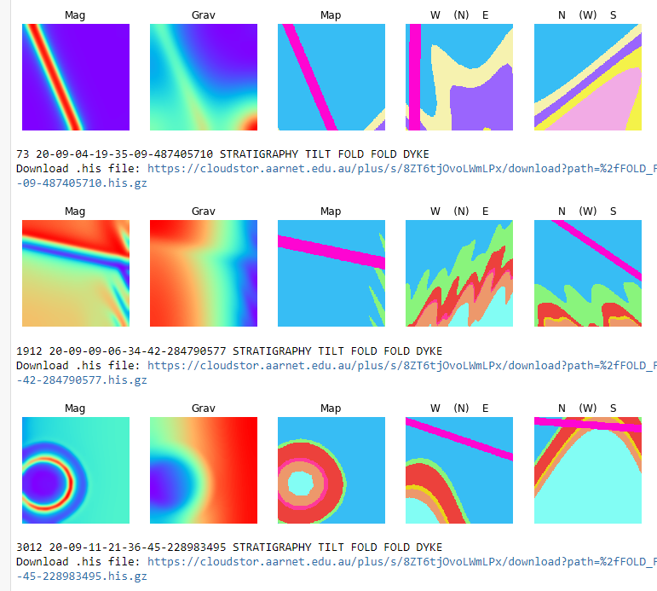
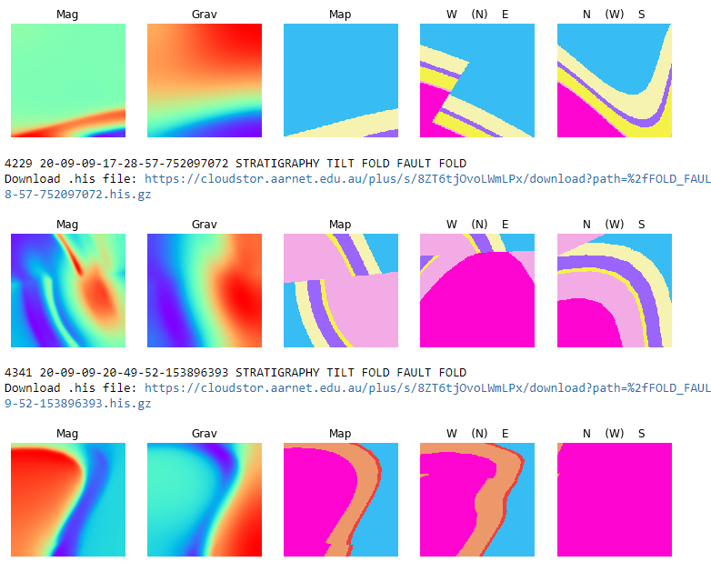
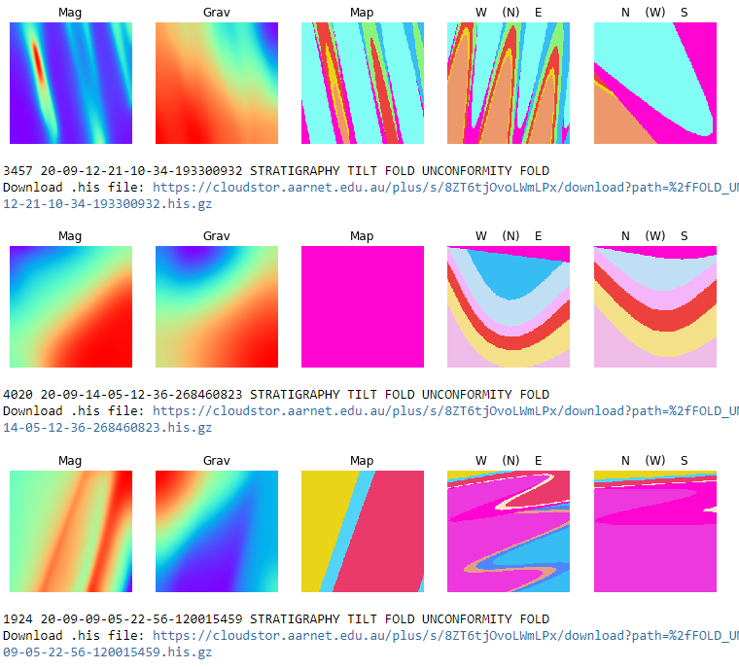


A new Challenge
Open Access 1M labelled model suite with more diverse geological histories including diverse stratigraphies available here:
github.com/Loop3D/noddyverse
sampling from 4036 models matching
['FOLD', ‘FOLD', ‘DYKE’]
event sequence
sampling from 7994 models matching
['FOLD', 'FAULT', 'FOLD’]
event sequence
sampling from 4094 models matching
['FOLD', 'UNCONFORMITY', 'FOLD’]
event sequence

Slide 17
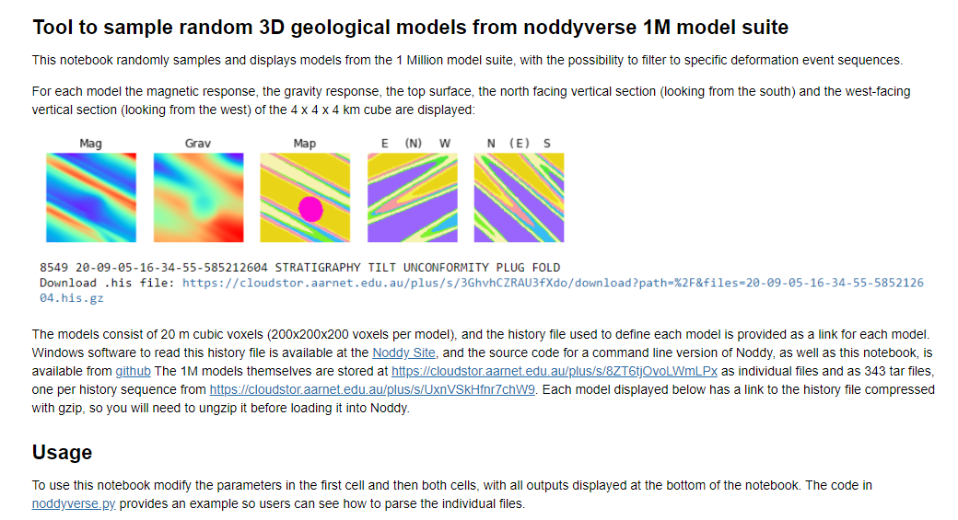

Slide 18
Can we generalise this method to more complex scenarios?
Use of Machine Learning in the geosciences needs labelled datasets, but the Google user base is too busy looking at cats to help us
In this study we have shown the potential of non-physics-based 3D modelling to provide large arbitrarily complex time-aware 3D models and their potential-field response
We can make a million models, we could even make a billion models, but we can’t make the trillions of models right now that would be needed to generalise this approach.

Slide 19
Hand over to Leo…

